Slide 1


Slide 2
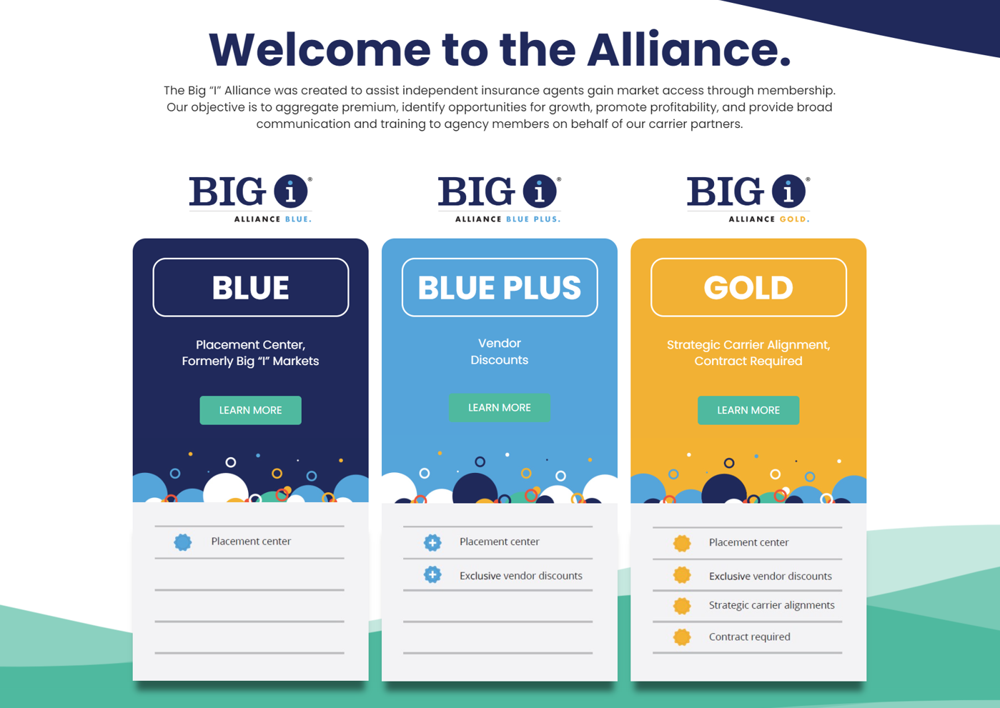
Notes:
Incubate, Accelerate, Aggregate

Slide 3

PLACEMENT CENTER
Connects member agents with top tier standard and E & S insurance markets
Auto and Home Standard and High Net Worth
Bonds of all types
BOP, Commercial Auto, Commercial Package Policies
Community Bank Package
Cyber & Management Liability
Jewelry
Non-standard Personal and Commercial Property
Real Estate Agents E&O
Workers Comp
No Volume Commitments
No Fees

Slide 4
PLACEMENT CENTER
Benefits of Blue to Big "I" Alliance Gold Members:
Grow your book of business to earn direct appointments with desired carriers. Carrier retains the right to appoint.
Earn potentially higher commission rates due to Big “I” Alliance’s carrier relationships.
Dedicated underwriters assigned to your agency.
Retain a book of business that could have been lost due to a carrier appointment termination, pending carrier approval.

Slide 5

AGENCY RESOURCES
Agents have access to exclusive pricing with​ vendor partners. ​
Agency Operations & Technology Solutions
Agency Support
Education
Hiring/Staffing
Marketing Co/Op
Marketing Support
Premium Finance Solutions
$100 annual fee
Not charged until ready to move forward with vendor
Payment will be made through ePay
Renewal invoice is sent 60 days prior to renewal to member

Slide 6

Big "I" Alliance Gold is IIABA's agency alliance. Qualified members who join enjoy these features:
Aggregated Premium
Contingency eligibility
Increased commission
Strong carrier partnerships
Opportunities for growth
Promotion of profitability
Broad communication and training
Market access through membership
Automatic Vendor discounts

Slide 7

Reasons to Join Big “I” Alliance Gold
Agency earns 100% of the commission, paid directly to agency
Agency owns codes and expirations. Agency receives downloads.
Aggregate production with core carriers to achieve higher commission structure
Potential to earn increased profit share based on higher tiers due to aggregation
Broad communication from carriers
Benefits Guide with vendor exclusive discounts
Alliance E & O - Possible savings
ROI $$$ - invest in your agency
Market Access when carriers open for new appointments or through Blue membership

Slide 8
Ideal Agency Prospect
Ready to maximize revenue by aggregation of premium with 3+ core-carriers
10 Employees or fewer
Not a member of another Alliance group
Agency Management System
Committed to writing new business with core carriers
Values carrier relationship
Three-year production/loss ratio review for carrier alignment
State/Region: Diversify carrier books of business and entire book of business. Limiting # of agencies we are partnering with by state.

Slide 9
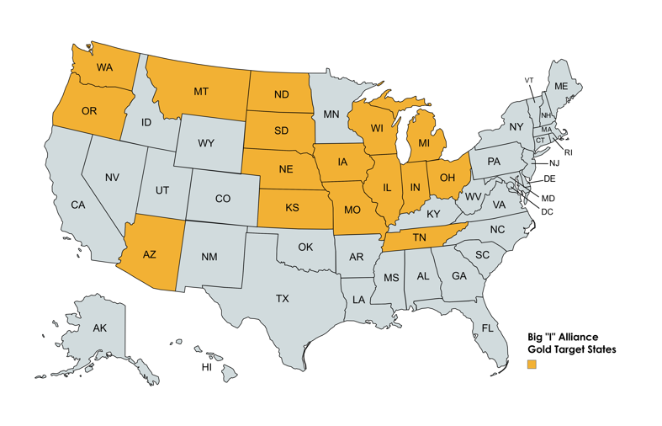
2024 Target States – Phase 1
*Open for consideration if prospect agency is located outside of identified states.
Notes:
States in gold are states we have identified as states our carrier partners want to grow, will consider new appointments and are open for new business. They have been identified as more profitable and less risk. If an agency prospect is outside of the states identified, they are still considered and evaluated to be a gold member.

Slide 10

Big "I" Alliance Gold Member Agreement
Initial three-year contract; automatically renews each year thereafter.
$2,500 one-time sign-up fee
$250/month membership fee
Termination/Buyout: 120 days written notice & monthly membership fee for remaining contract. Premiums stay until Jan. 1st of following year.
Profit Share – Sliding scale.

Slide 11
Profit Share Overview
Year 0 – 3
Minimum of 80% Profit Share Payout
Year 4+
$0 - $39,999 80% Profit Share Payout
$40,000 - $79,999 90% Profit Share Payout
$80,000 + 100% Profit Share Payout

Slide 12

Typical Network/Alliance/Aggregator Costs
Average Cost to Buy-in $10,000-$50,000
$500+ monthly membership fee or % of revenue
Contract requirement 7-15 years
May give up ownership
Shared commission %
Potential non-ownership of code
Required to use partnered AMS
Termination fee to leave
Non-compete

Slide 13
Acuity
Arlington Roe
Berkley Management
Branch
Bristol West
Chubb
Cowbell Cyber
Crump Life
Delos
Employers WC
Foremost Choice
Foremost Signature
Forge
Hanover
Hartford CL
Jewelers Mutual
Liberty Mutual
National General
Nationwide
Openly
Pie
Propeller Bonds
Safeco
Steadily
Travelers PL
Travelers Commercial Select
*In negotiation with other carriers.
Notes:
More carriers to come in 2024 & 2025

Slide 14
Additional Gold Member Benefits:
Alliance E & O Policy
Business Consultant
Talage
Commercial Lines Rater
Add to agency website & through email link
(Co/Op opportunity for Gold Agents & access to Blue commercial
carriers)
Dedicated Personal Lines Underwriter with Big I Alliance Blue
Vendor Discounts
Collaborate & partner with other Gold members & Big I Alliance staff
More to come…
Alliance intranet that will host a forum available to all agents, carrier product guides, communications & claims contact info.
Notes:
Premium Finance Partner: IPFS If agency is currently a member of state big I and is accessing IPFS’ endorsed program through the State Association will keep revenue. Any new member agency who joins Eagle Alliance who doesn’t have an existing relationship with IPFS through their state association, will share revenue with Eagle Alliance. More details to come.

Slide 15

GOLD – Alliance E&O Policy
States remain point of contact for sale and servicing
17% Commission (split 12% commission & 5% royalty)
Profit Sharing to states
Up to 20% premium reduction
Ease of applying & renewing
Key advantage of belonging & sticking with Gold

Slide 16
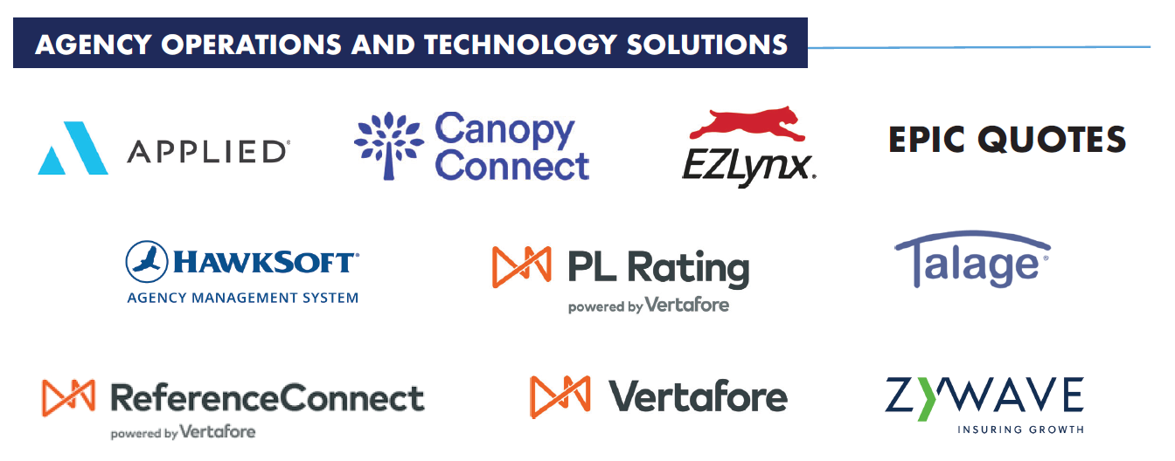

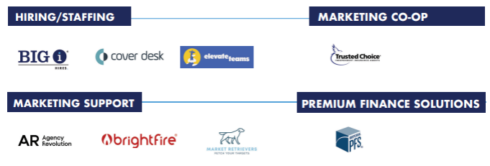
Vendor Partners
Notes:
Premium Finance Partner: IPFS If agency is currently a member of state big I and is accessing IPFS’ endorsed program through the State Association will keep revenue. Any new member agency who joins Eagle Alliance who doesn’t have an existing relationship with IPFS through their state association, will share revenue with Eagle Alliance. More details to come.

Slide 17

Questions &
Answers

